Slide 1







Interactive Analytics: Bringing Tableau Data to Life with Langchain
+
Joseph Fluckiger
Principal Software Engineer at Tableau

Slide 2

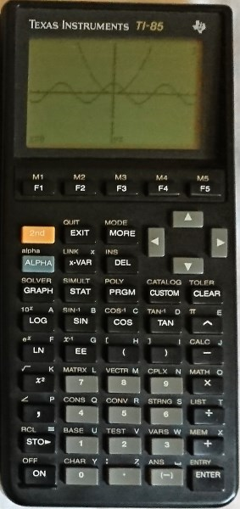
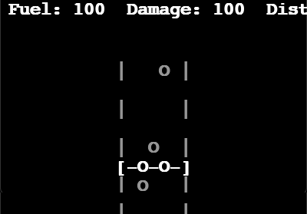
About Me - Joseph Fluckiger
Work: Principal Software Engineer @ Tableau (Salesforce)
Background: Software, Devops, AI
FOSS: Python, Machine Learning, Life Sciences, Cloud Devops
First Gaming Platform: TI-85 Calculator
Socials:
https://www.linkedin.com/in/josephflu
https://github.com/josephflu
https://josephfluckiger.blogspot.com
Notes:
I remember a bet that I made a friend: Ilijits Boss. 2002. Whoever writes a program that is deemed Artificially intelligent

Slide 3
Programming Evolution
Traditional Programming: Data + Rules = Answers
Machine learning: Data + Answers = Rules
Generative AI: Rules (Models) + Scale = Intelligence
LangChain: Intelligence + Tools = Autonomous Agents 🚀
Notes:
We’re all here at TDX to learn about building the future of software development, but before we talk about the future, I want to reflect for a moment on Tableau’s past.
Tableau exploded onto the market 20 years ago because it was the best tool for visually exploring data and building beautiful visualizations.

Slide 4
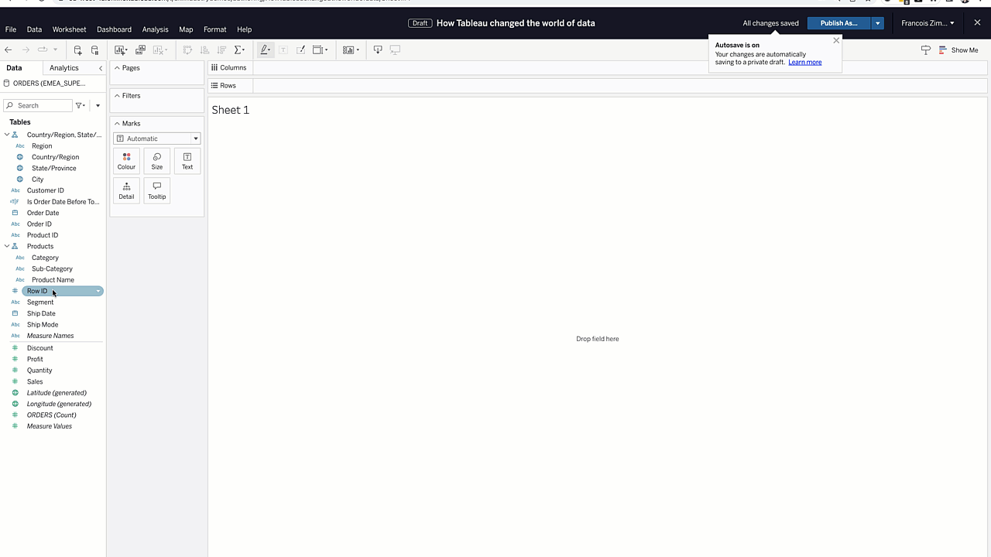
Tableau is Famous for its Ease of Use
Empowering organizations of all sizes to learn insights from their data
Notes:
We’re all here at TDX to learn about building the future of software development, but before we talk about the future, I want to reflect for a moment on Tableau’s past.
Tableau exploded onto the market 20 years ago because it was the best tool for visually exploring data and building beautiful visualizations.

Slide 5
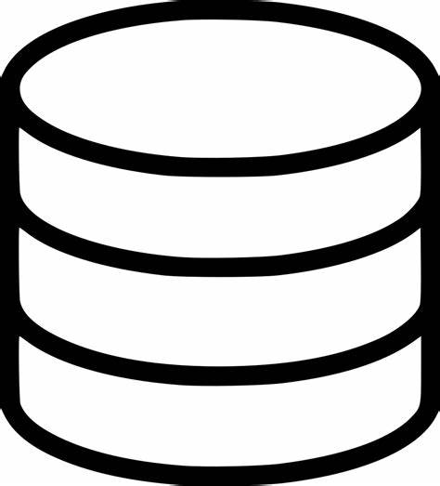

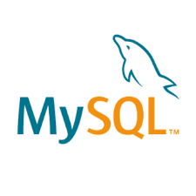


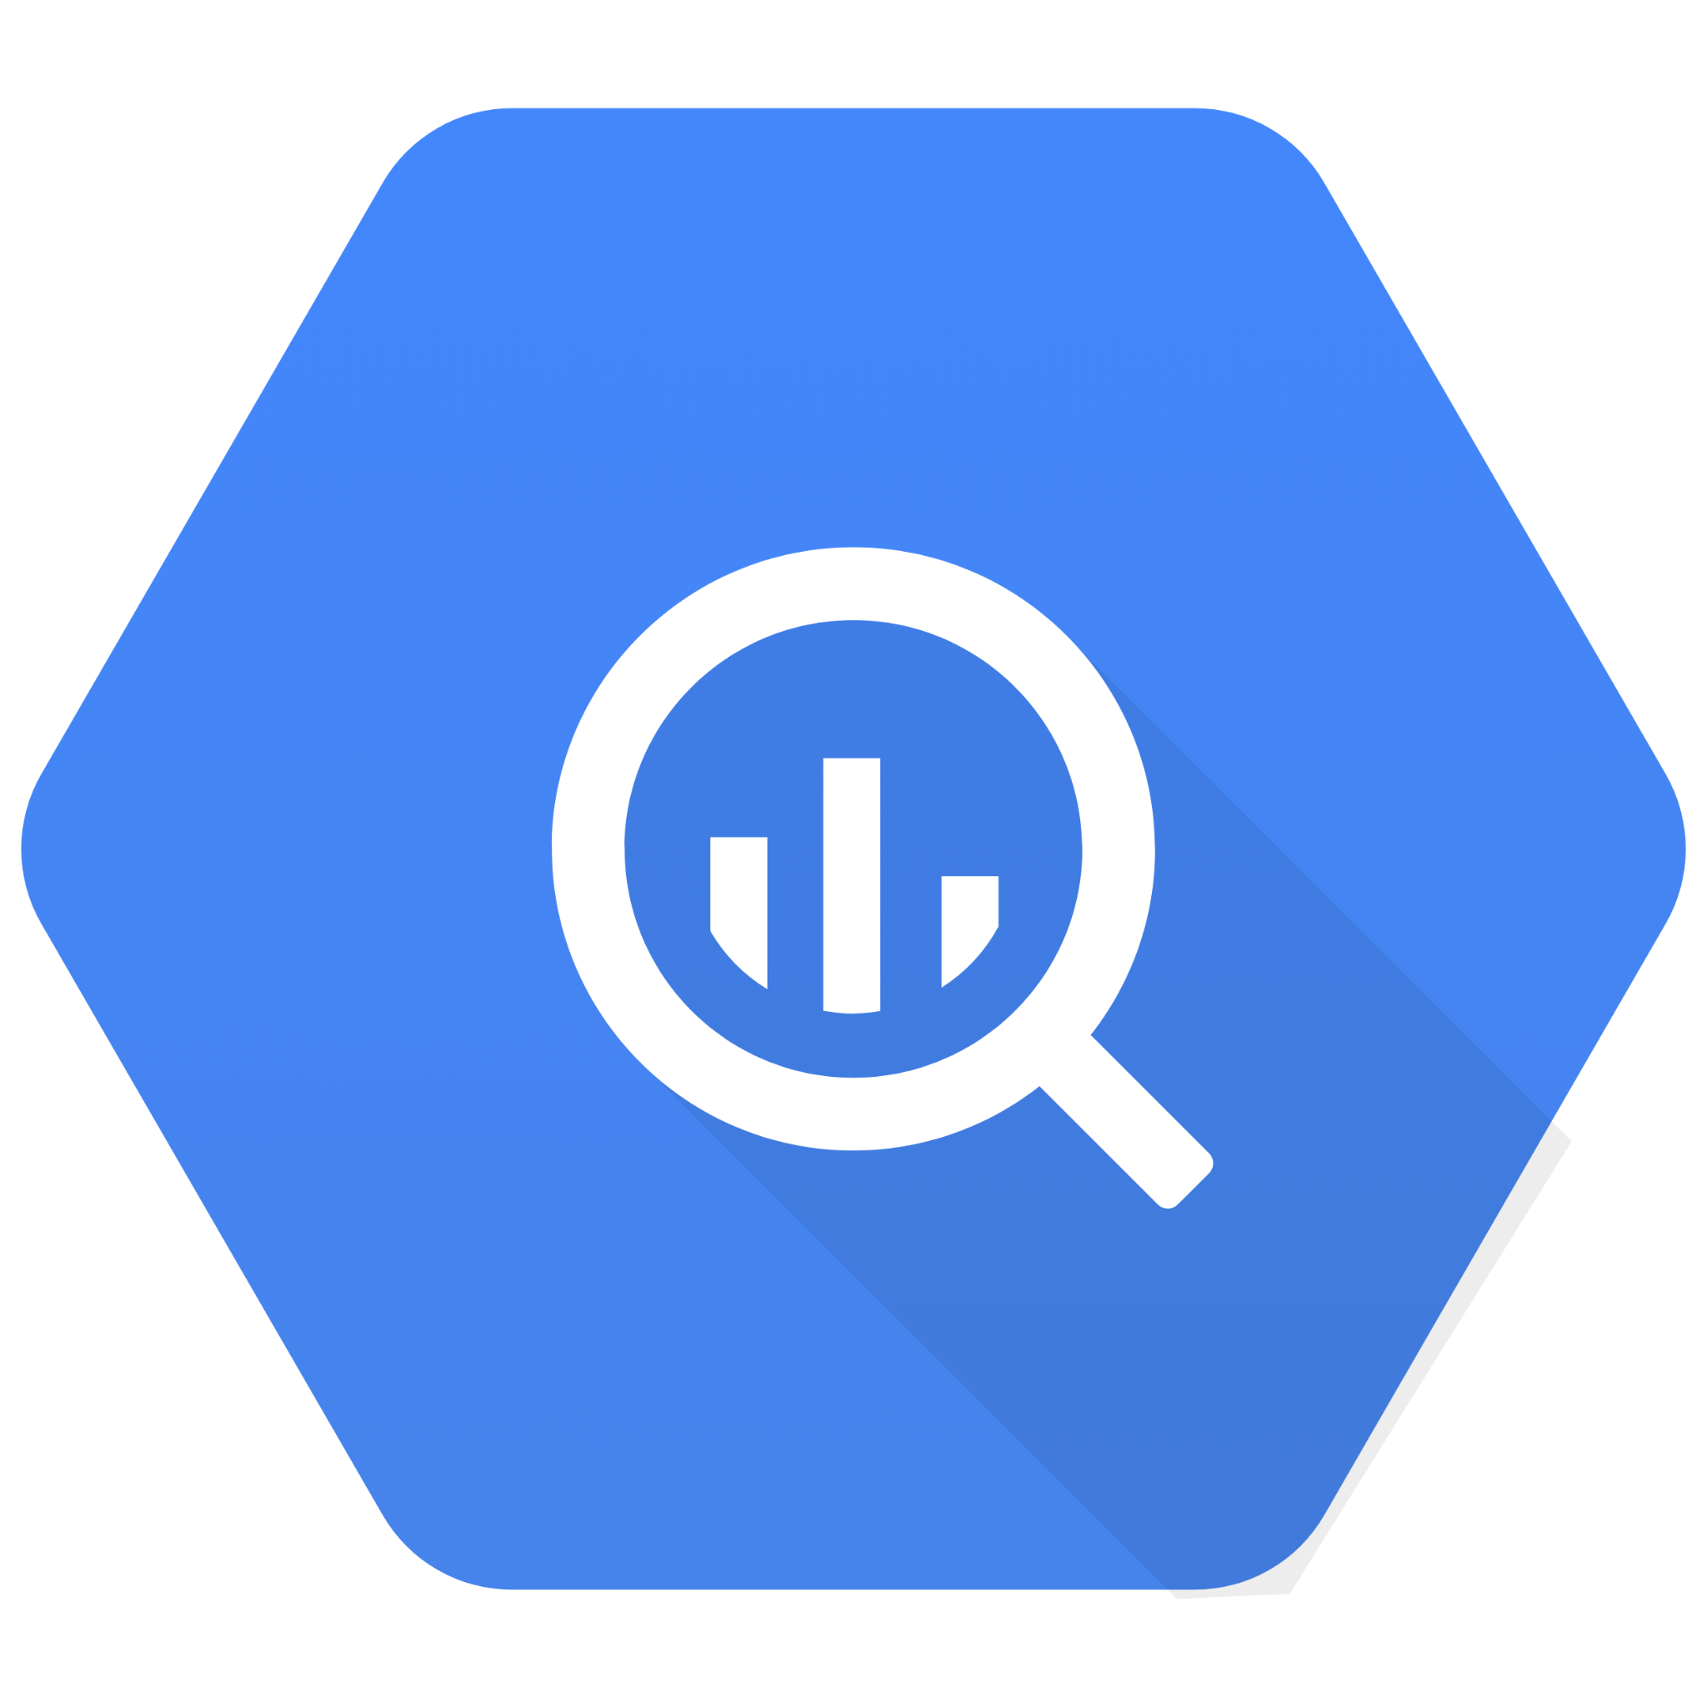
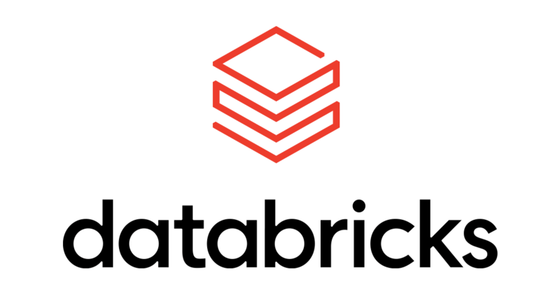




Historically, Semantic Modeling in Tableau was only in Service of Visual Exploration
Business Semantics
Relationships,
Multi-fact,
Calculations,
Hierarchies,
Groups,
Aliases,
Formats
Published Data Sources
Tableau Connectivity
Notes:
Because of that, the Tableau #datafam, our community of builders, started modeling their data in Tableau and Tableau has enriched its data modeling and connectivity layers, to support this. Tableau Published data sources became THE thing that houses all the data modeling actions that a data analyst will take to build out a data model.
That encompasses all the things from connecting to one or more types of data sources, relating them, building calcs on top, creating hierarchies, and so on and so forth. In short, this is the place where you all would imbue your raw data with business meaning, and then make that available to people in your organization to self-service insights. When you do this, your stakeholders only have to worry about putting pills on shelves to get the analysis they need. This is the power of VizQL and the Tableau Platform. It’s the ability to simply drag a pill and then generate complex semantic queries that account for all the data modeling logic you’ve defined.
But the problem was, that all this modeling was only in service of visualization.

Slide 6





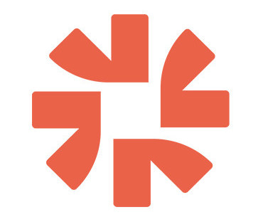



New VizQL Service enables powerful workflows with LangChain
VizQL Data Service
Published Data Source
Notes:
We want the Tableau community to be able to leverage their Tableau-modeled business semantics while working the most popular llm-app dev frameworks and tools - whether their open source, part of Salesforce, or even 3rd party vendors.

Slide 7
What is VizQL Data Service?
A new Tableau service that sits alongside our existing REST services
Accessed via HTTP and uses JSON as the content type
Uses standard Tableau Authentication
Two primary endpoints
Read Metadata - to get information about a Published Datasource
Query Datasource - to send a query to a Published Datasource
Notes:
VizQL Data Service is a new Tableau Service that sits alongside our existing Tableau REST services. It’s accessed in many of the same ways, via HTTP and uses JSON as the content type for requests, and responses. It uses the same standard Authentication methods as our existing REST services. It’s comprised of two primary endpoints, one for extracting metadata about a published datasource, and another for executing a query against a published datasource. The Query API provides a simple and well defined set of Query Semantics that hopefully will be very familiar to a Tableau User. And it’s available both on Server and Cloud in the 2025.1 release.

Slide 8
Langchain Tableau Package
+

Slide 9
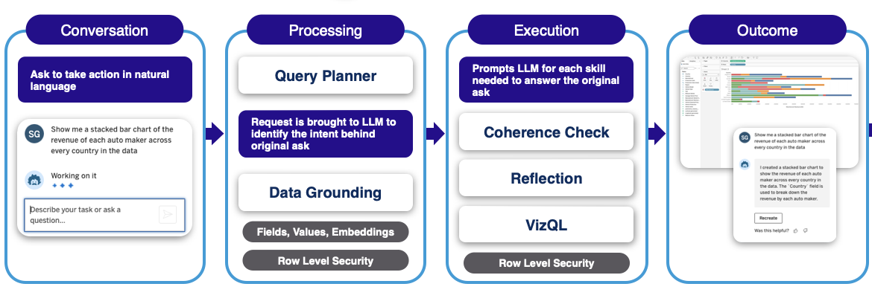
How Tableau Langchain Works

Slide 10

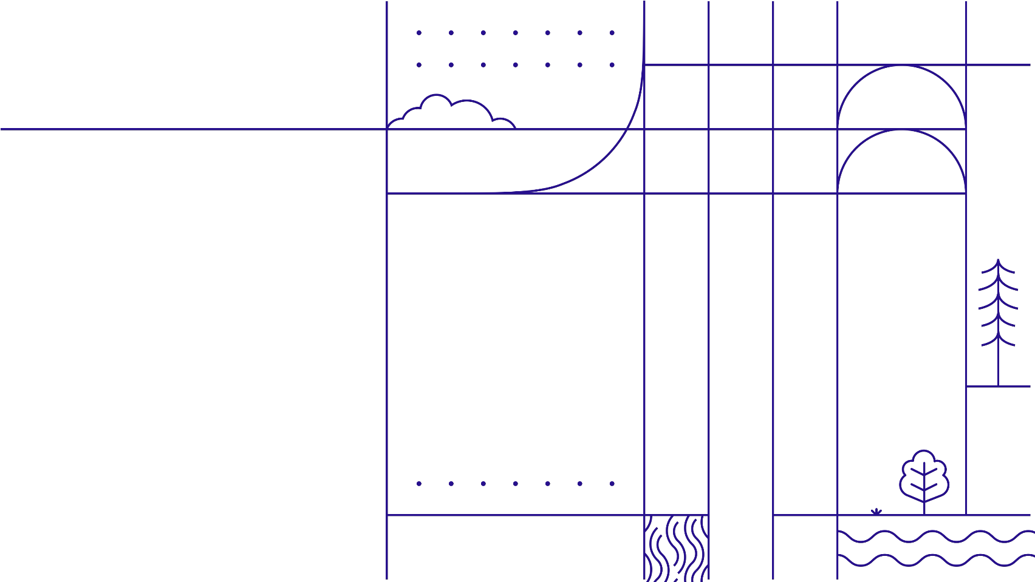
Demo

